Slide 1
JapanRailFan
Japan Rail Enthusiast Website – Web Development – Joseph Lee

Slide 2
Purpose
To let train enthusiasts explore and learn the different train rolling stock, lines and operators in Japan.
Allows users to view and calculate ticket prices (JR Rail Pass, tourist passes)

Slide 3
Content
Types of railways in Japan (Subway, JR network)
Types of trains (High-capacity, High-speed trains)
Trains by lines
View ticket types and prices
Calculate ticket prices
Picture gallery of train rolling stock

Slide 4
Technologies
Bootstrap with additional modifications for user interface
HTML forms and JavaScript for ticket calculator
JavaScript for displaying information

Slide 5
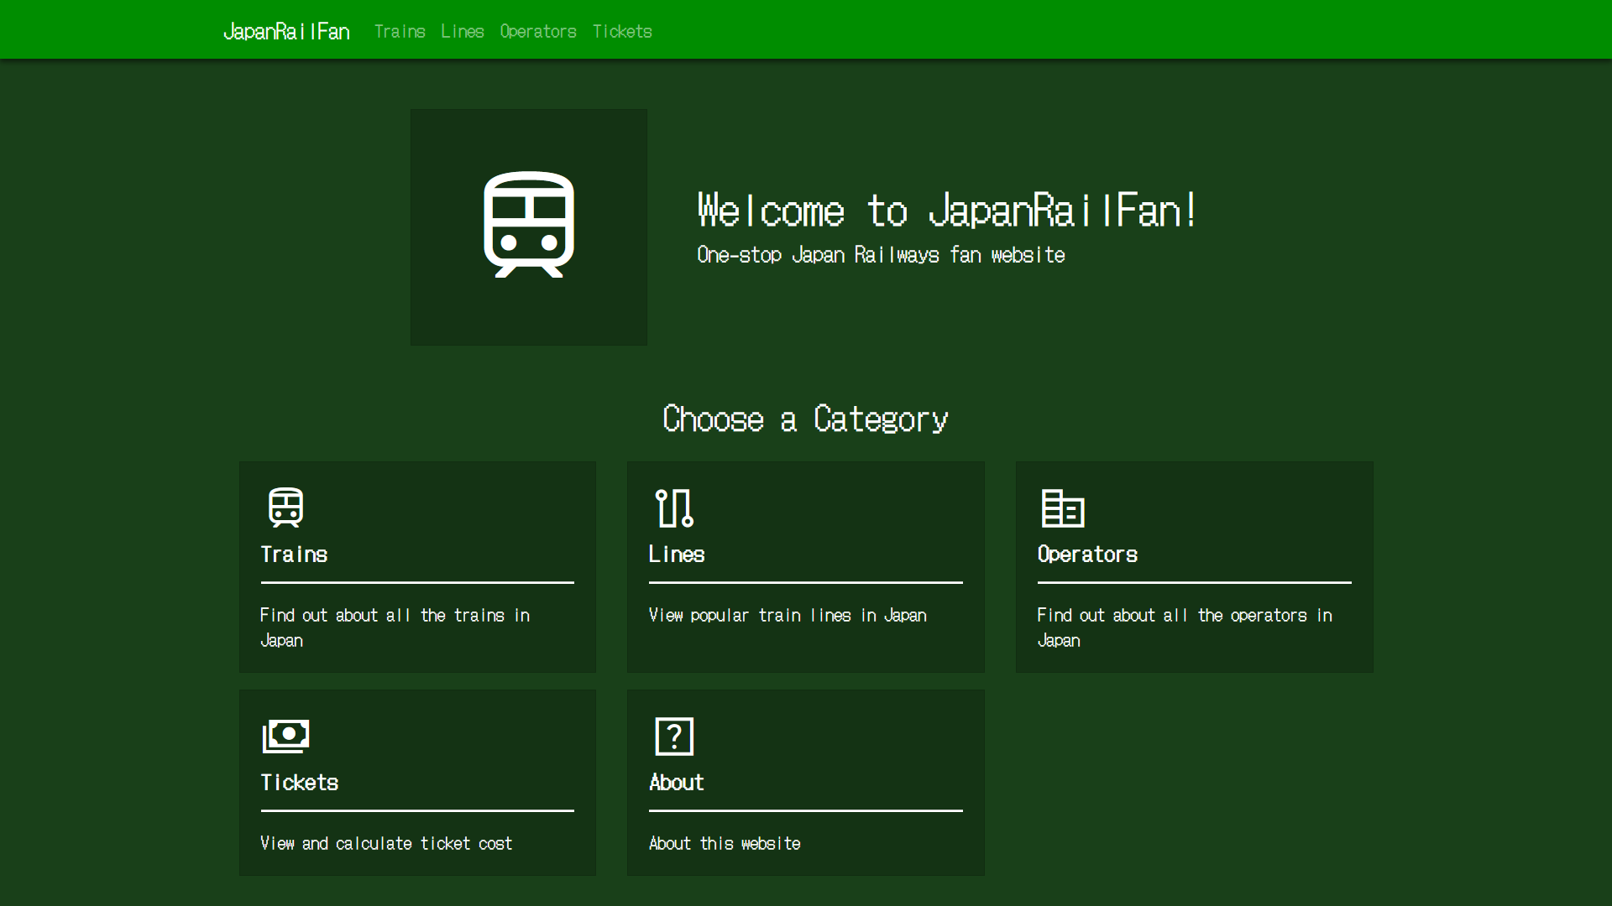
Homepage (Work-In-Progress)

Slide 6
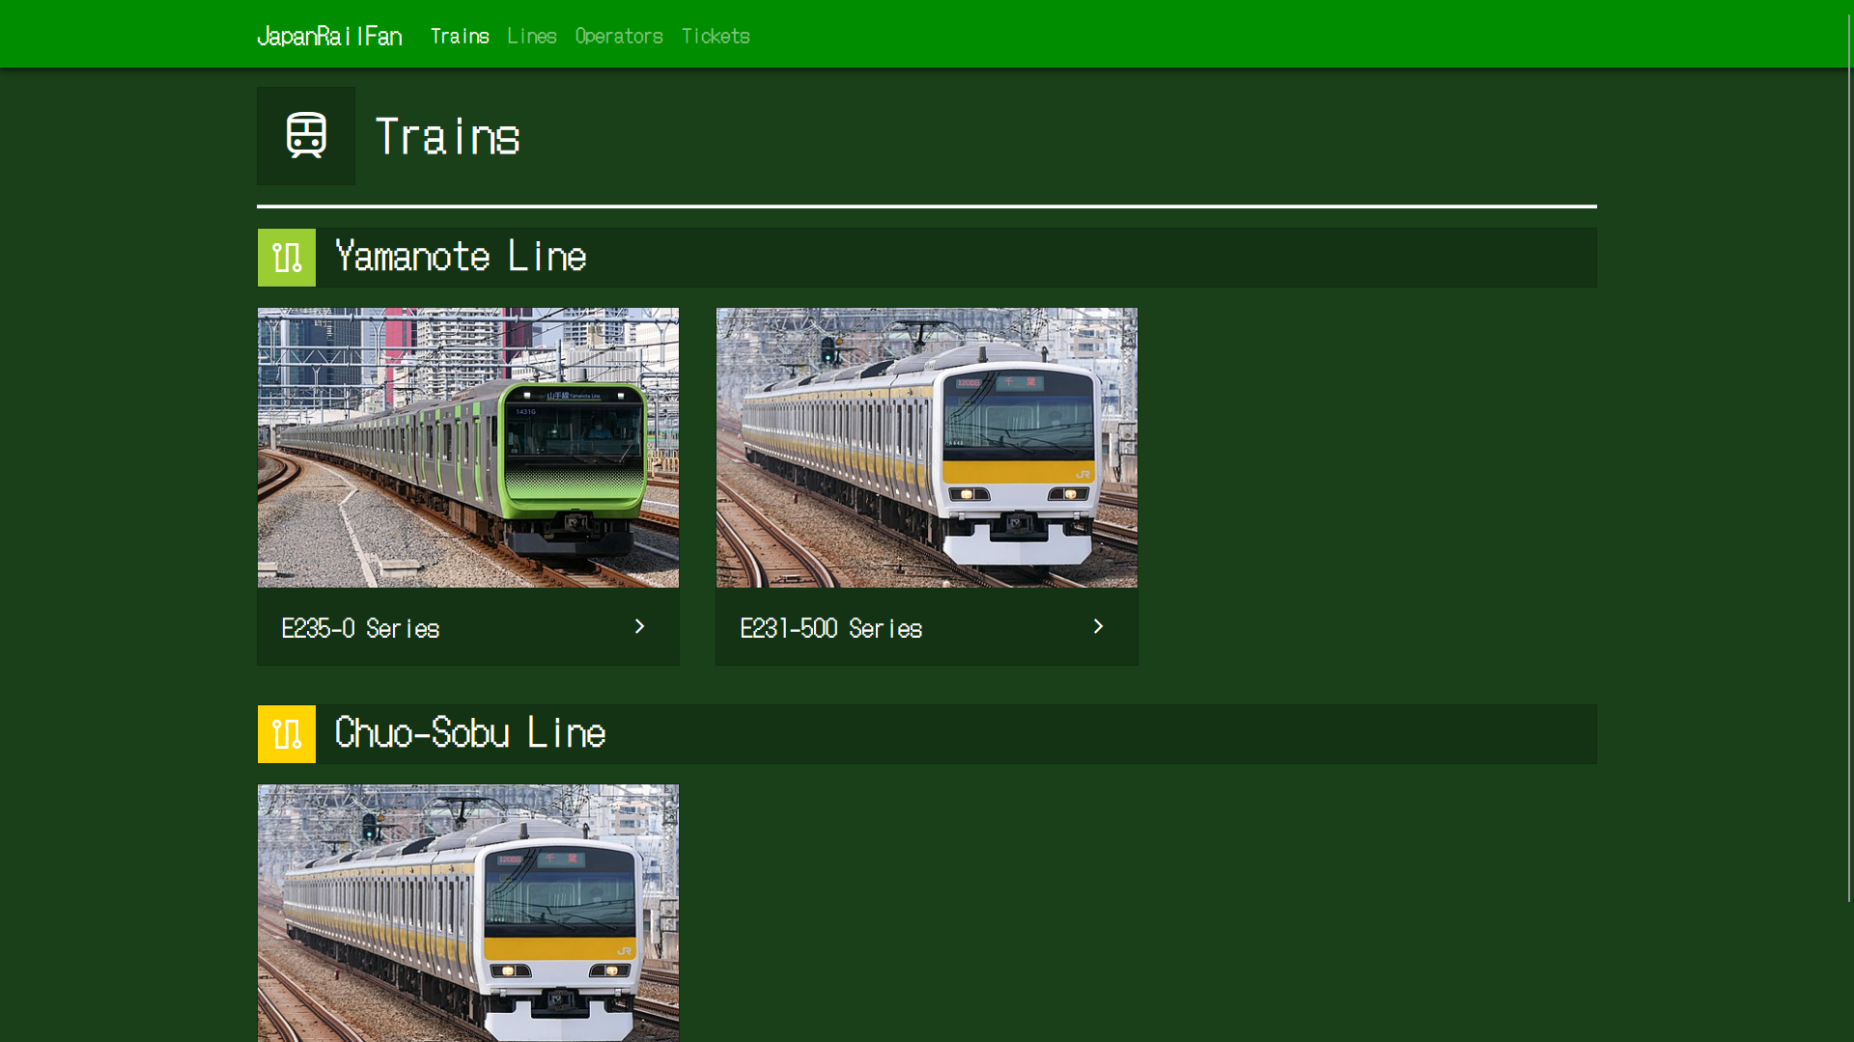
Train rolling stock by line

Slide 7
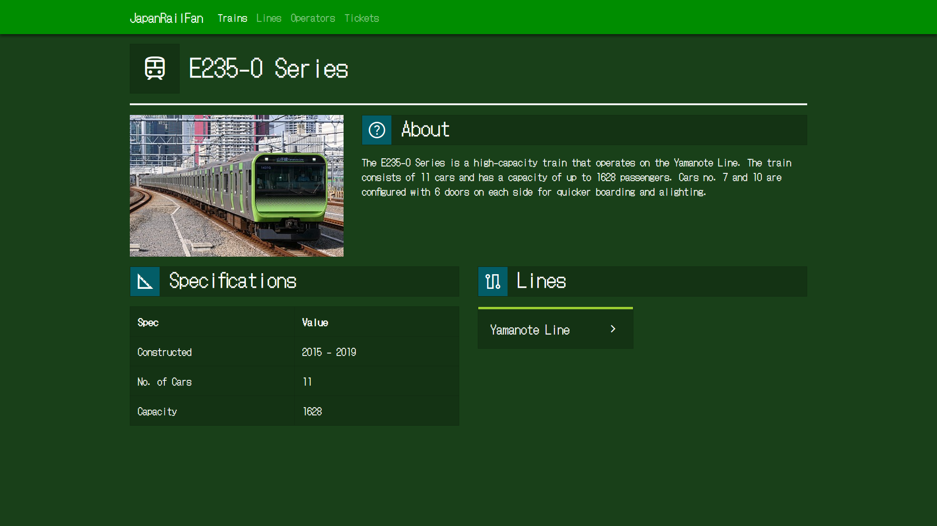
Rolling Stock Information

